Slide 1
Sunrun CRM Release Management

Slide 2
Code Migration Path
Ditto
DevLocal
DevMaj
QA
MajStg
Prod
Notes:
Salesforce component migration process

Slide 3
Github Process
Working Directory
Staging
Area
Git Directory
(Repository)
Checkout the project
Stage Files
Commit
Notes:
Github process

Slide 4

Version Controlling Process
DevLocal
DevMaj
QA
MajStg
Retrieve
Deploy
Deploy
Retrieve
Deploy
Deploy
Prod
Retrieve
Retrieve
Merge
Merge
Merge
DevLocal Branch
DevMaj Branch
QA Branch
MajStg Branch
Retrieve
Deploy
Merge
Prod
Master Repo
Ditto
Branch
Retrieve
Deploy
MajStg
Notes:
Steps:
Checkout DevLocal branch to local working directory
Retrieve the files from DevLocal sandbox to working directory using Ant migration tool
Check-in the files to DevLocal branch
Merge the changes from DevLocal to DevMaj branch
Checkout DevMaj branch to local working directory
Deploy the changes to DevMaj sandbox

Slide 5
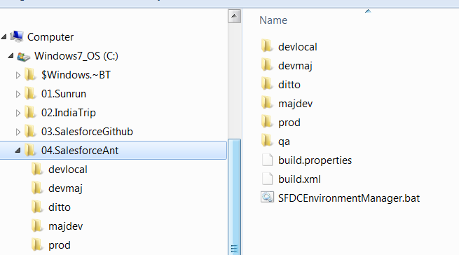
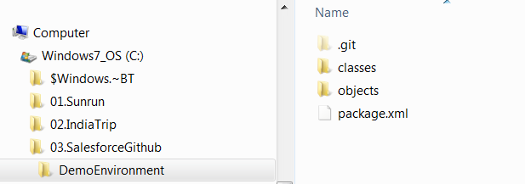
Folder Structure
Salesforce Git Folder Structure
Salesforce Migration Tool Folder Structure

Slide 6
SFDCEnvironmentManager
C:\04.SalesforceAnt\DemoEnvironment>SFDCEnvironmentManager.bat
Sunrun SFDC Environments
1.DevLocal
2.DevMaj
3.Qa
4.MajStage
5.Ditto
6.Prod
Enter Environment#1
Task Names
1.Retrieve
2.TestDeploy
3.Deploy
Enter Task#1

Slide 7
You have selected DevLocal_Retrieve
Removing objects/Account.object
Removing objects/Contact.object
M objects/SampleObject1__c.object
M package.xml
Already on 'DevLocal'
Your branch is up-to-date with 'origin/DevLocal'.
Buildfile: C:\04.SalesforceAnt\DemoEnvironment\build.xml
DevLocal_Retrieve:
[sf:retrieve] Request for a retrieve submitted successfully.
[sf:retrieve] Request ID for the current retrieve task: 09S6300000053JpEAI
[sf:retrieve] Waiting for server to finish processing the request...
[sf:retrieve] Request Status: InProgress
[sf:retrieve] Request Status: Succeeded
[sf:retrieve] Finished request 09S6300000053JpEAI successfully.
BUILD SUCCESSFUL
Total time: 14 seconds

Slide 8
Tools For Version Control
GitHub
SourceTree
Force.com Migration Tool
GitHub Repositories
Salesforce Code:
SFDCEnvironmentManager:
  https://github.com/raghuzcloudinc/SFDCEnvironmentManager.git

Slide 9
References
https://git-scm.com/
https://github.com/
https://www.sourcetreeapp.com/
http://www.salesforce.com/us/developer/docs/apexcode/Content/apex_deploying_ant.htm
https://developer.salesforce.com/page/Force.com_Migration_Tool

Slide 10
The End

